Slide 1
Computational Prediction of Boundaries of 3D Genomic Domains in Class Imbalance Settings
Spiro C. Stilianoudakis¹ (stilianoudasc@mymail.vcu.edu)
Mikhail G. Dozmorov¹ (mikhail.dozmorov@vcuhealth.org)
¹Dept. of Biostatistics, Virginia Commonwealth University, Richmond, VA, 23298, USA

Slide 2
Outline
Spatial organization of the human genome
Topologically associated domains (TADs)
Epigenomics
Addressing data irregularities and characteristics
Establishing relationships between annotations and TADs
Class imbalance issues
Predictive Modelling
Suitable performance metrics
Identifying most informative features
Conclusions
Future Work

Slide 3
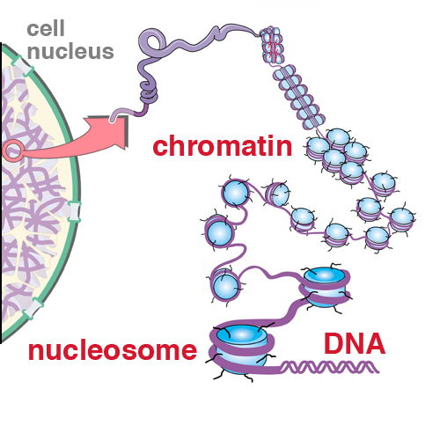
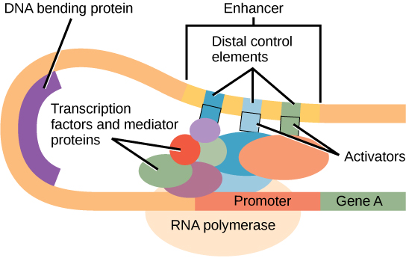
The Human Genome
The genome is composed of 22 pairs of autosomal chromosomes
Includes approximately 3 billion base pairs (A/T/C/G)
DNA must create compact loops to fit inside the nucleus of a cell
http://www.personal.psu.edu/sxt30/projects_chromatinenzymes.html
https://courses.lumenlearning.com/wm-nmbiology1/chapter/reading-eukaryotic-transcription-gene-regulation/

Slide 4
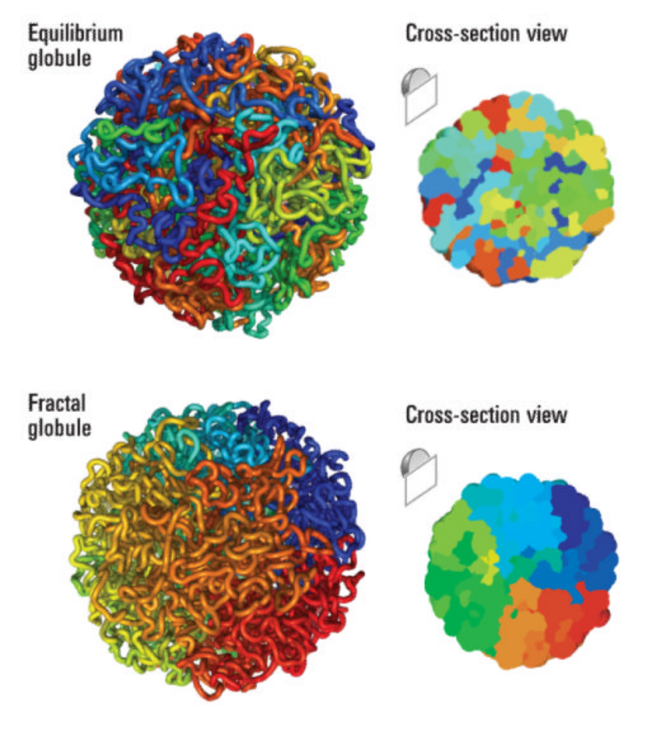
Chromosome conformation capture techniques
A set of molecular biology methods used to analyze the spatial organization of chromatin in a cell.
Quantify the number of interactions between genomic loci that are nearby in 3-D space, but may be separated by many nucleotides in the linear genome

Slide 5
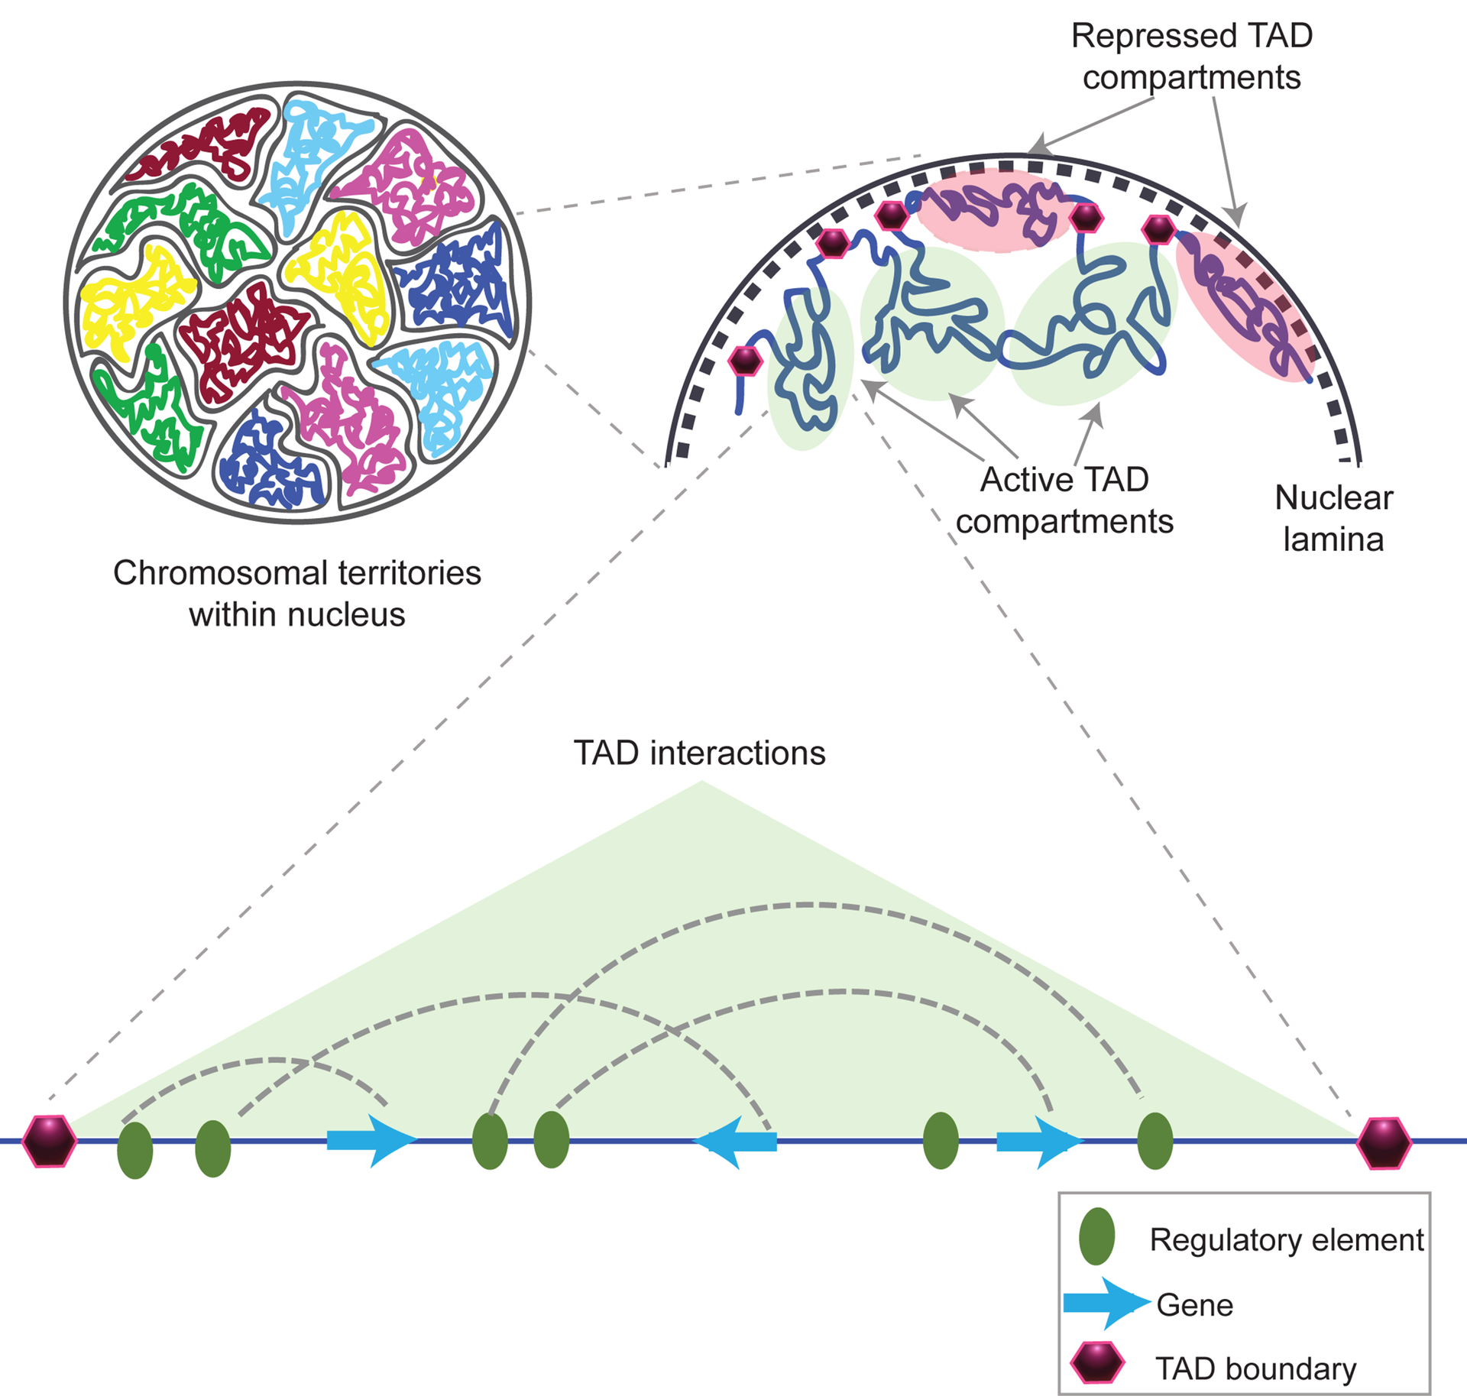
Topologically Associating Domains
Hi-C sequencing technologies have shown that the genome is tightly compacted into distinct compartments termed topologically associating domains (TADs)
The entire genome can be partitioned into two spatial compartments such that greater interaction occurs within each compartment rather than across compartments

Slide 6
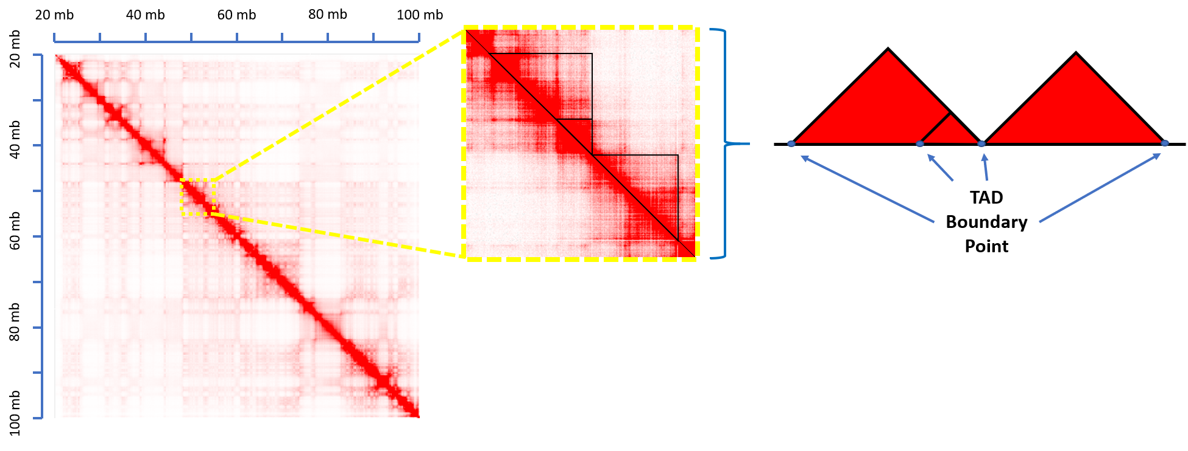
Topologically Associating Domains
TAD Calling Algorithms are used to delineate the regions on the linear genome that define a TAD.
The partitioning of the genome into TADs is hierarchical in nature
Many different algorithms have been proposed for identifying TADs from Hi-C data
http://aidenlab.org/juicebox/

Slide 7
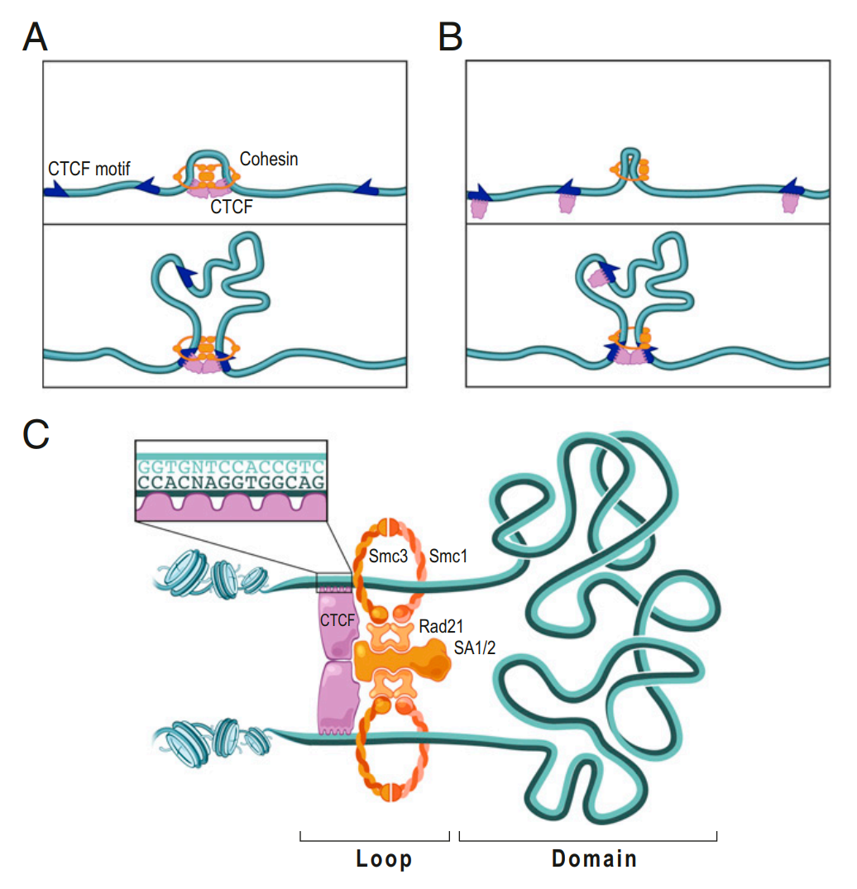
Characteristics of TADs
Evidence suggests that regulatory elements and genes tend to interact more frequently within the same TAD.
Boundaries of TADs may play a role in restricting the function of certain genomic elements such as enhancers, thereby impacting the transcription of genes.
Approximately 60-80% of TADs remain stable across cell types.
Studies have shown that changing the 3D structure of the DNA, causing disruptions in these domains, can lead to adverse outcomes and diseases like cancer.
It is unclear what the complete set of genomic-specific features are that correlate with TAD boundaries

Slide 8
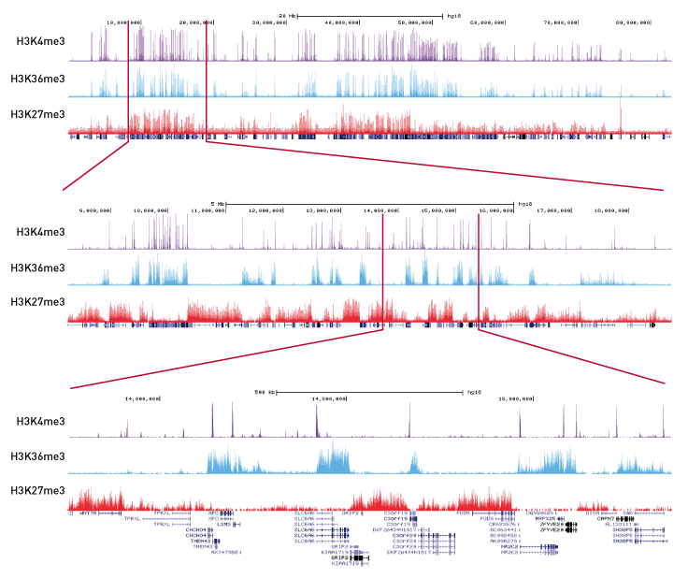
Relating TAD Boundaries to Epigenomic Functions
Epigenomics is the study of the complete set of molecular modifications that contribute to differential functionality in the genome
Protein coding genes only account for about 1% of the DNA sequences in the human genome.
They provide an opportunity to identify and understand how chromosomal structures act throughout the other 99% of the genome
Consists of chromatin states, histone modifications, transcription factor binding sites, DNAse I hypersensitive sites, etc.
Notes:
Combines chromatin immunoprecipitation (ChIP) with massively parallel DNA sequencing
Determines how transcription factors and other chromatin-associated proteins influence phenotype-affecting mechanisms

Slide 9
Using epigenomic annotations to predict TAD formation
We aim to create a classification algorithm that efficiently and correctly identifies the functional genomic elements most predictive of the formation of TAD boundaries
Create and ensemble framework in which we answer the following questions:
How severe is class imbalance?
What type of predictors improve model performance?
Which functional genomic elements are most predictive of TAD boundaries?

Slide 10
Domain Data Source
Publicly available Replicate Hi-C data was obtained for the GM12878 and K562 cell lines from GEO GSE63525
The autosomal genomic coordinates (GRCh37/hg19 human genome assembly) of TAD boundaries were obtained from data at 10 kb, 25 kb, 50 kb, and 100 kb resolution using the Arrowhead algorithm (developed by Rao et. al (2014))
Identified TAD boundaries were represented by their genomic coordinates.

Slide 11
Genomic Annotation Data Source
Genomic annotation data were obtained from the UCSC Genome Browser Database
Consisted of:
Chromatin states
Histone marks
Rranscription factor binding sites
DNAse Hypersensitive Sites

Slide 12
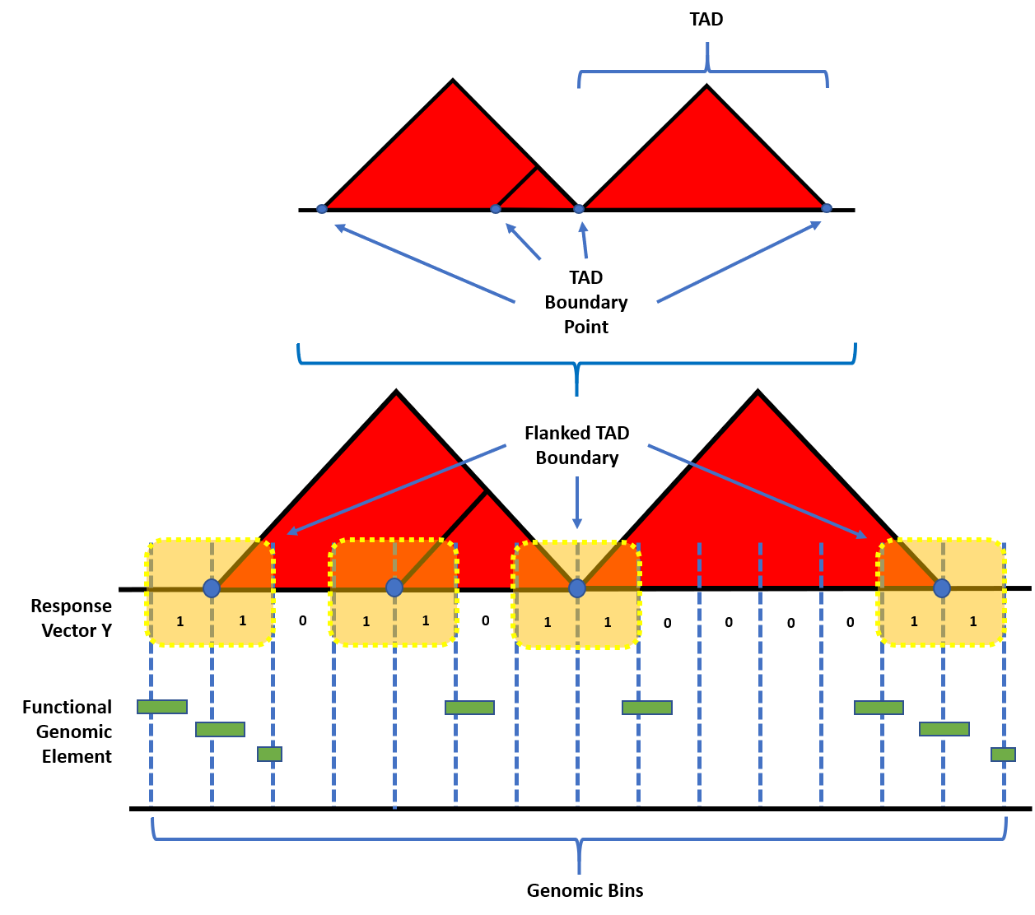
Model Construction: Establishing the response
More info

Slide 13
Model Construction: Re-sampling Techniques
No Sampling: All of the data points from the majority and minority class of the training set were used.

Slide 14
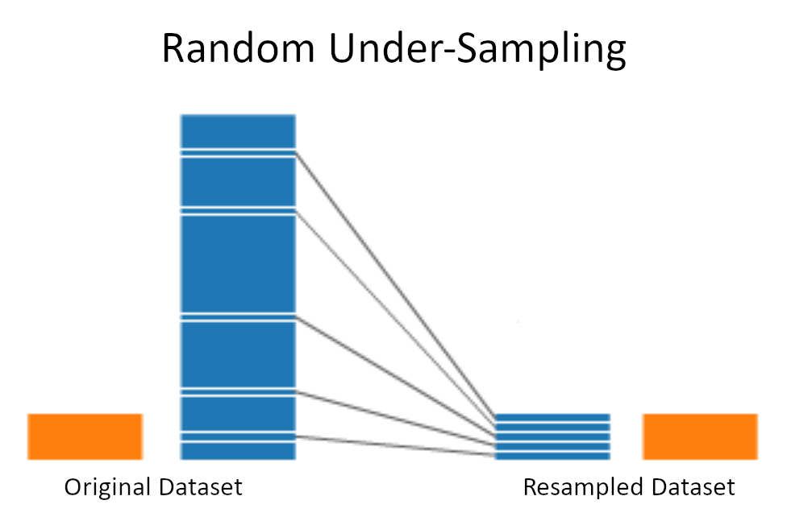
Model Construction: Re-sampling Techniques
Random Under-Sampling (RUS): All of the minority classes from the training set were used. Sampling without replacement was used to obtain the same number of the majority classes.

Slide 15
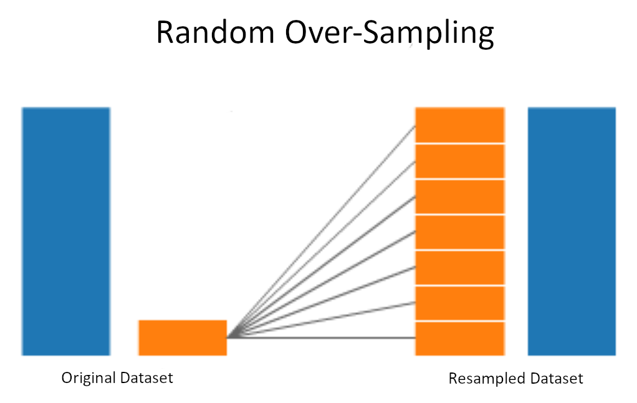
Model Construction: Re-sampling Techniques
Random Over-Sampling (ROS): All of the majority classes from the training set were used. Sampling with replacement was used to obtain the same number of the minority classes.

Slide 16
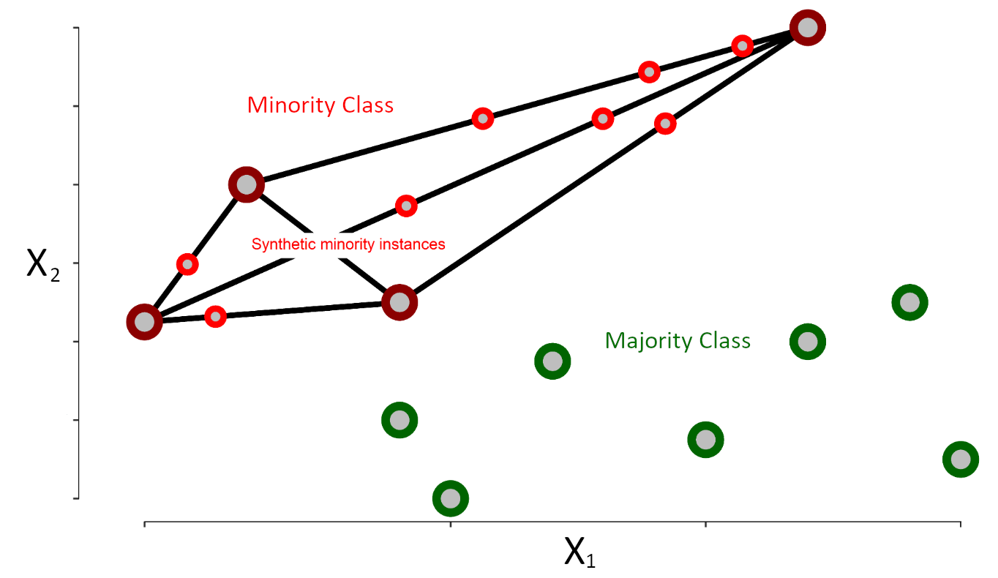
Model Construction: Re-sampling Techniques
SMOTE (Synthetic Minority Over-Sampling Technique): Incorporates both random under- and over-sampling. Under-sampling is performed without replacement from the majority class, while over-sampling is performed by creating new synthetic observations using the minority class. The DMwR R package was used to perform SMOTE (version 0.4.1).

Slide 17
Model Construction: Feature engineering
More info

Slide 18
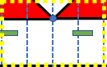
Model Construction: Predictor Types
Overlap Counts
1
0
1
1

Slide 19
Model Construction: Predictor Types
Overlap Percents
Feature Width
Bin Width

Slide 20
Model Construction: Predictor Types
Log₂ Distance
D₁
D₂
D₃
D₄

Slide 21
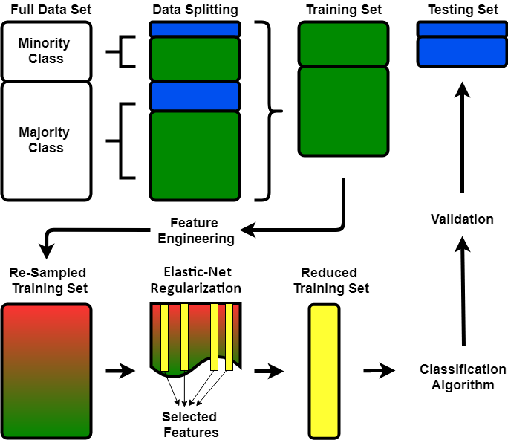
Ensemble Framework
More info

Slide 22
Predicting TAD Boundary Formation

Slide 23
Final Model Assessment and Performance

Slide 24
Complete ensemble comparisons

Slide 25
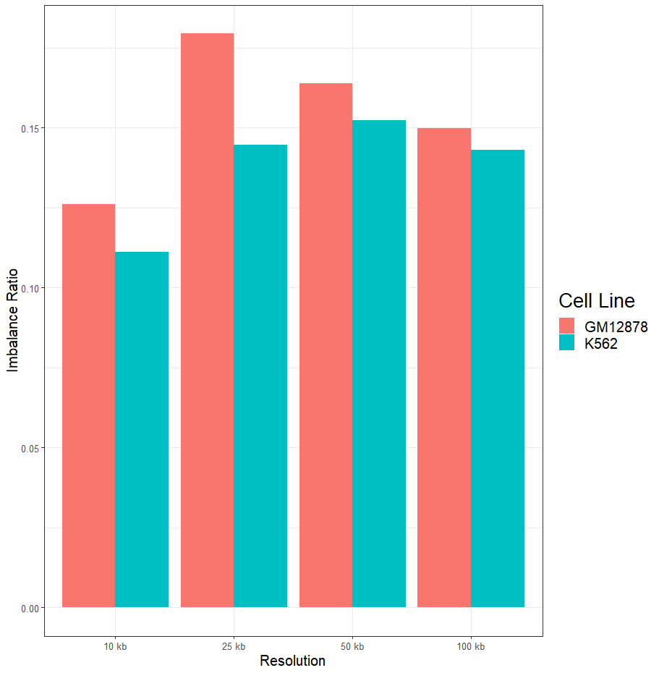
Imbalance Ratios Remained Severe & Consistent Across Resolutions
More info

Slide 26
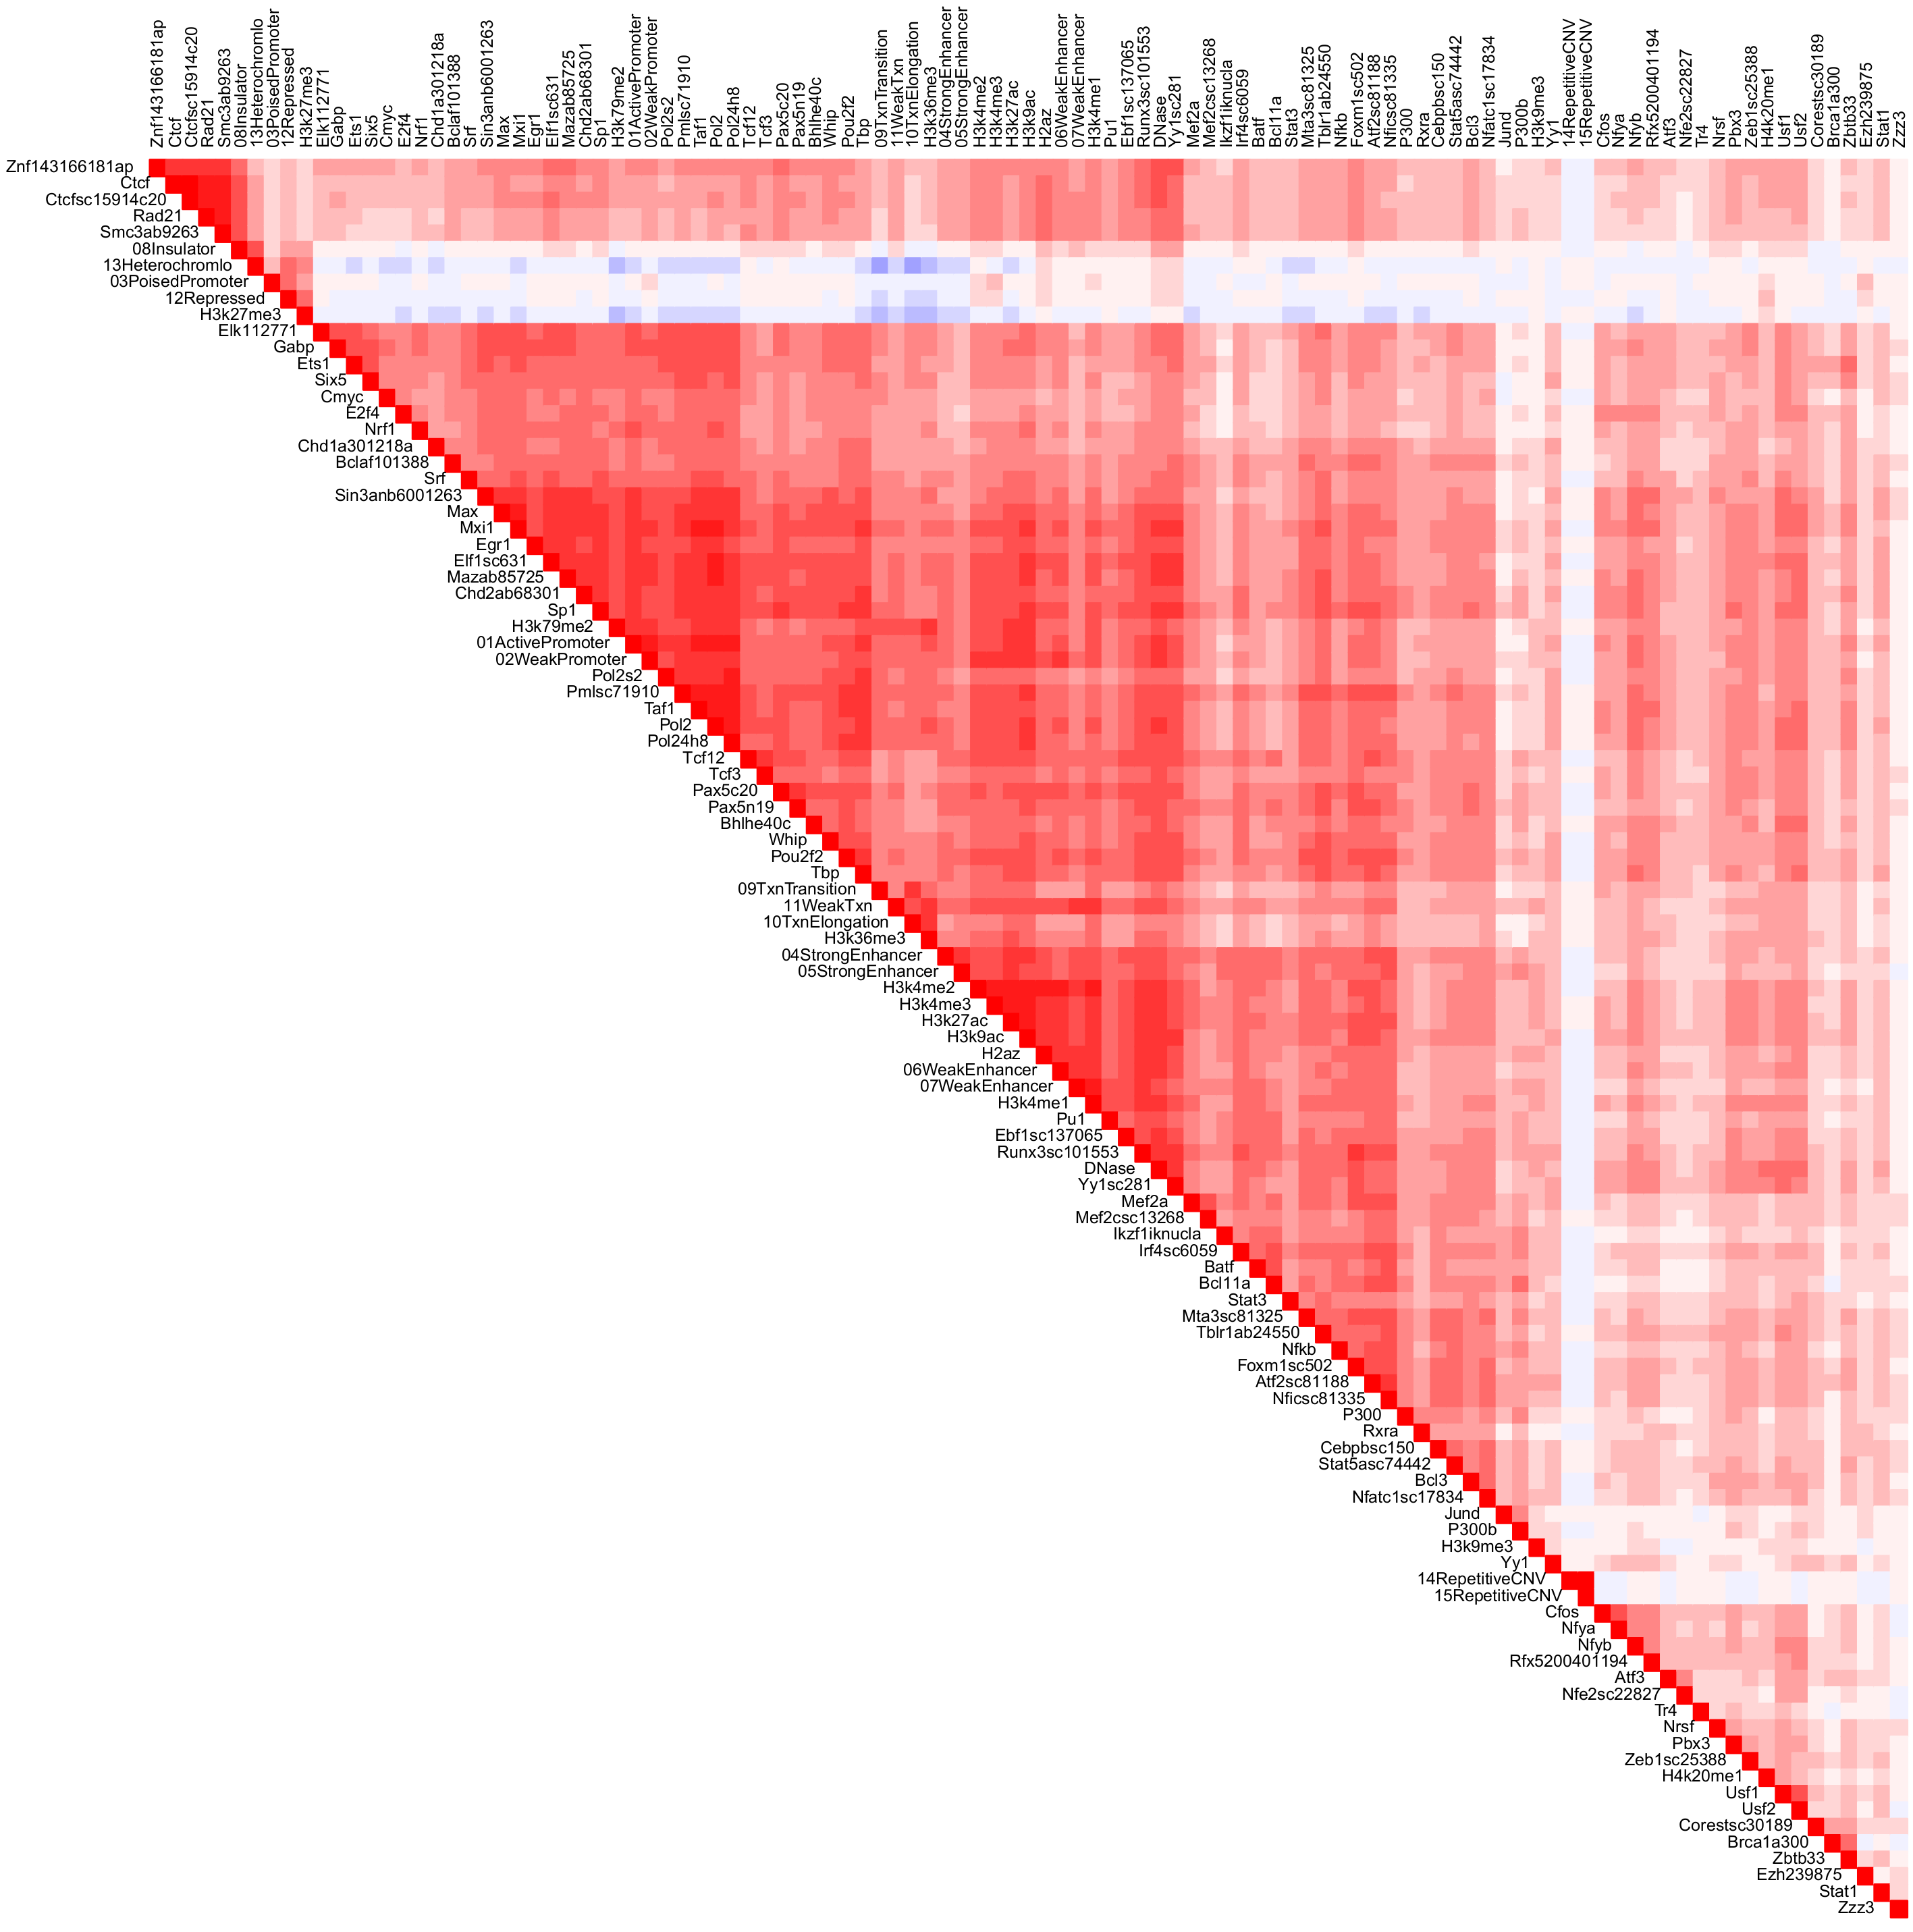
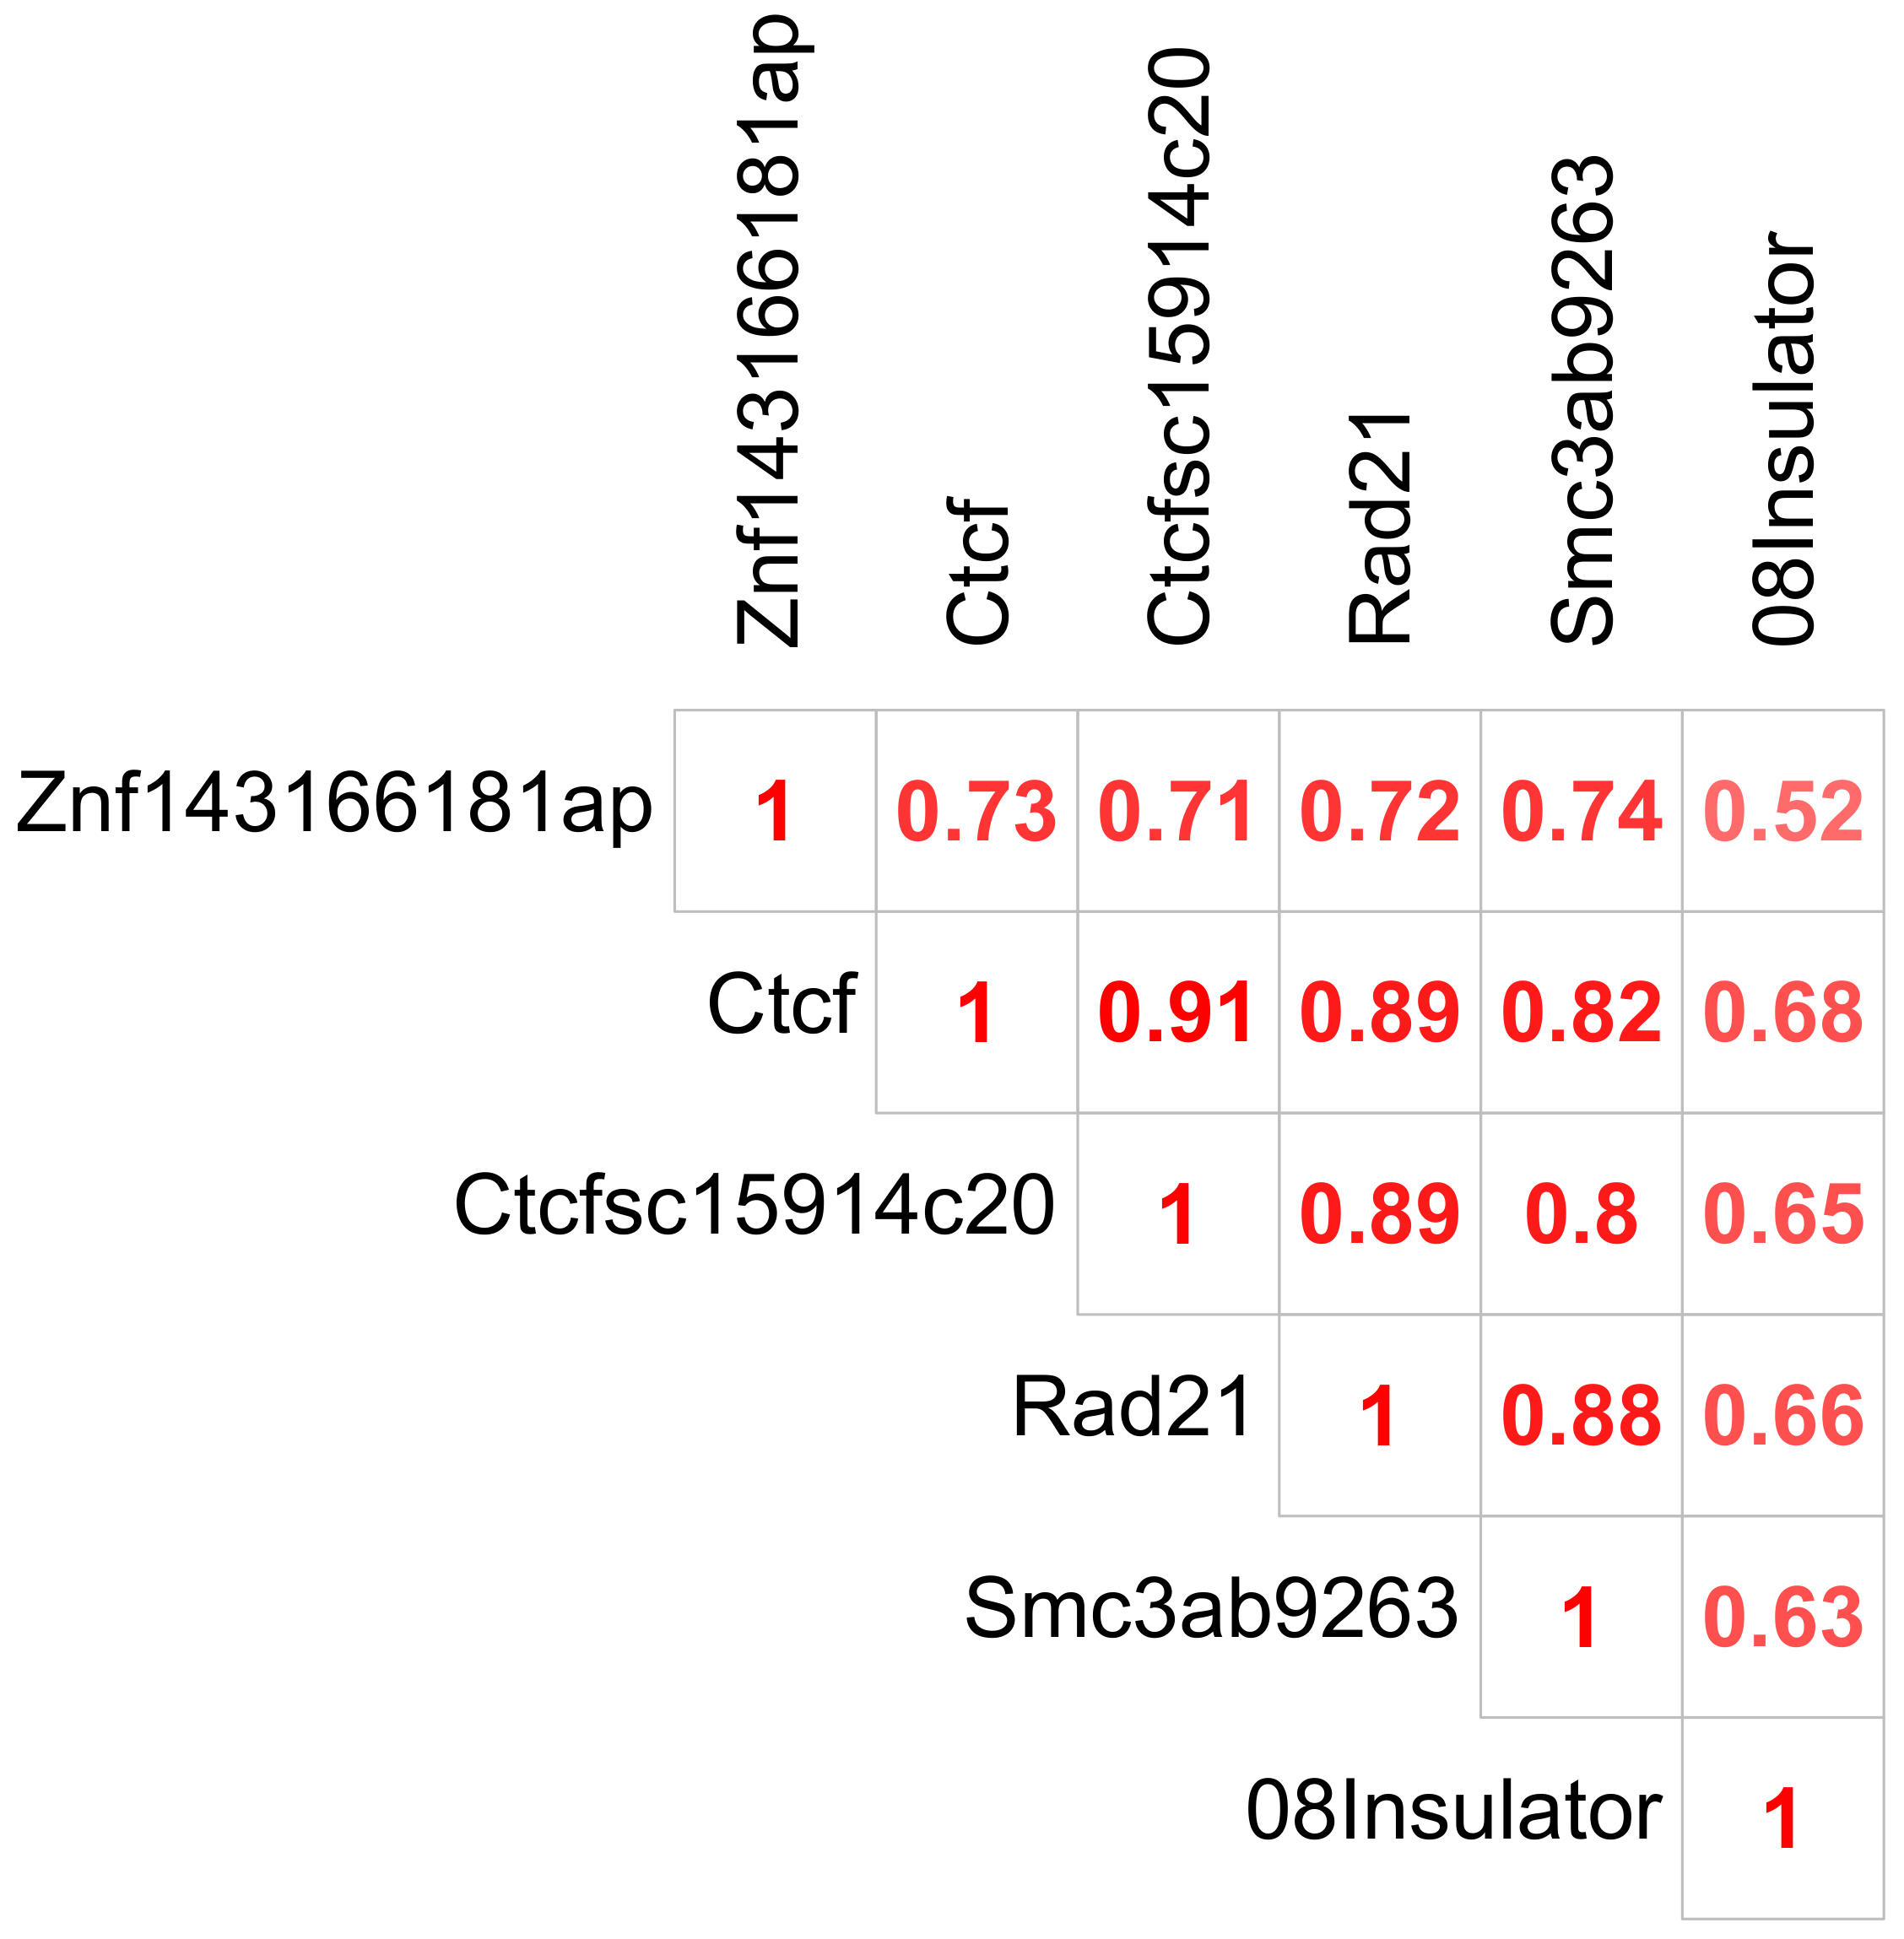
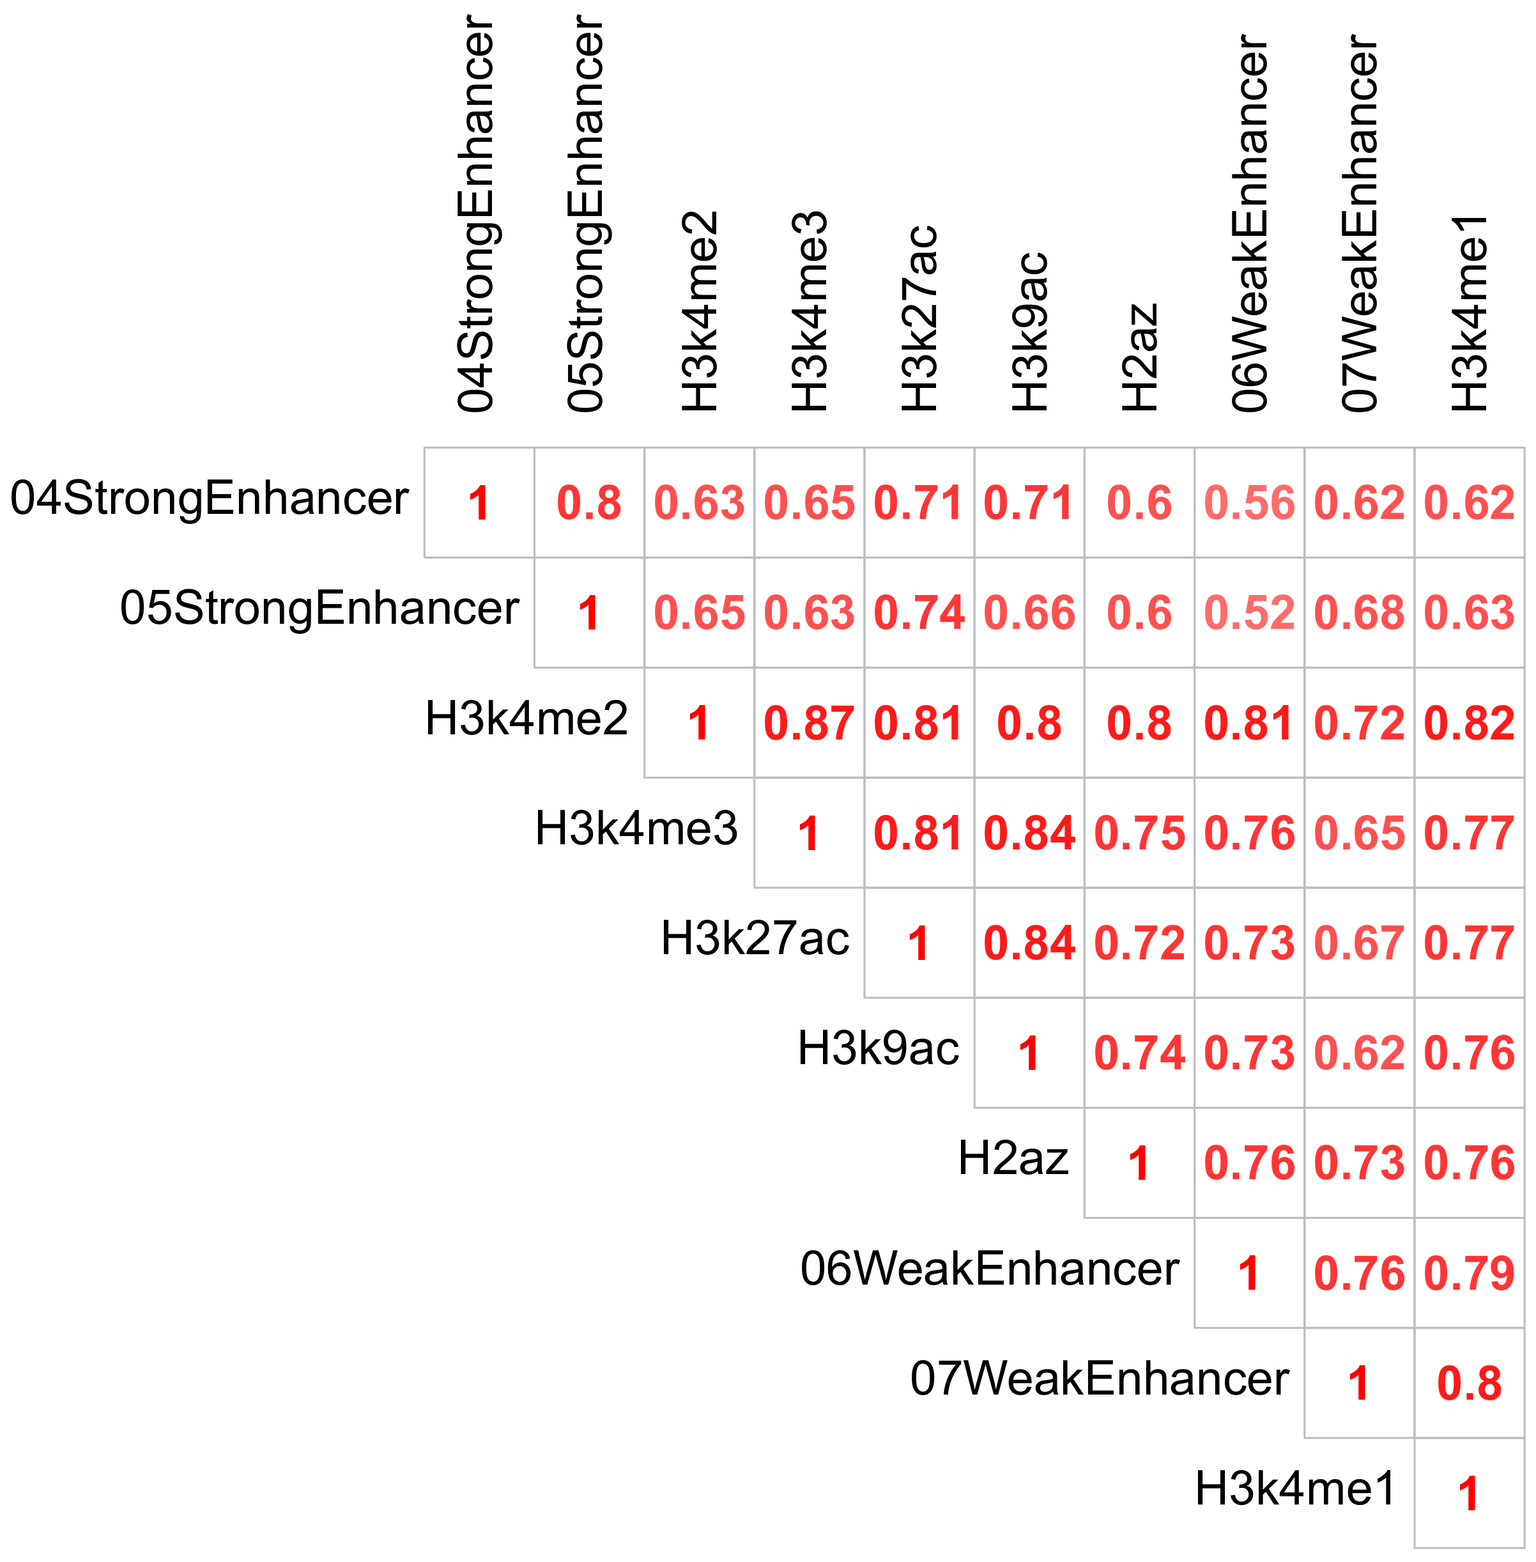
High Correlations Imply Colocalized Annotations Around TAD Boundaries

Slide 27
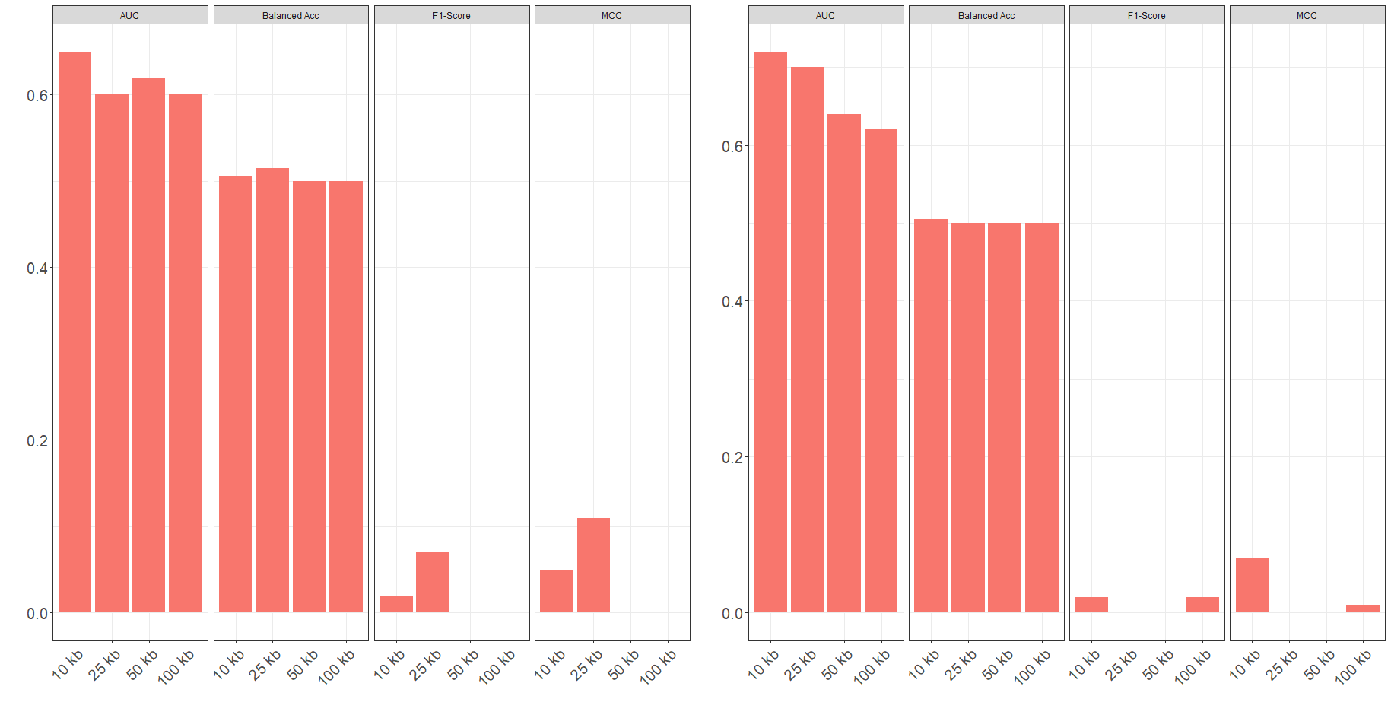
Class Imbalance Severely Impacts Model Performance Across Resolutions
More info

Slide 28
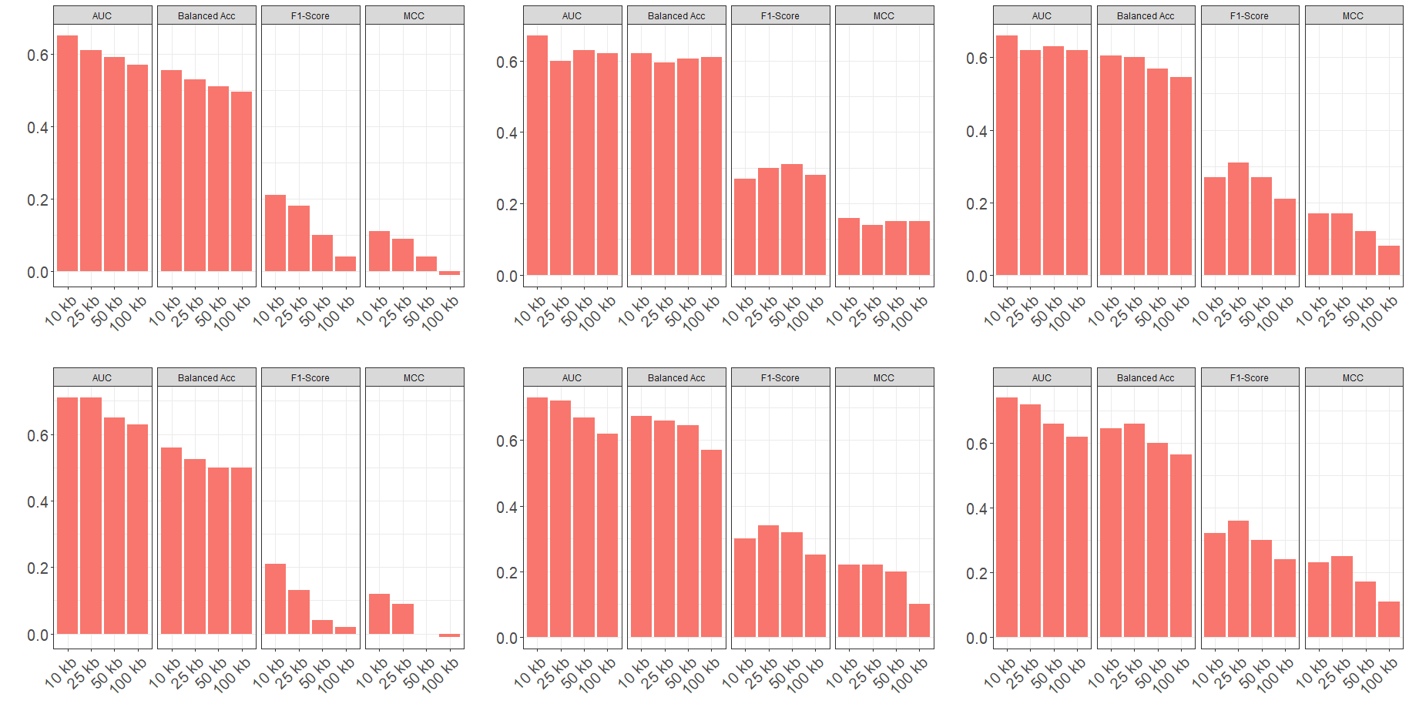
Data Re-Sampling Drastically Improves Model Performance

Slide 29
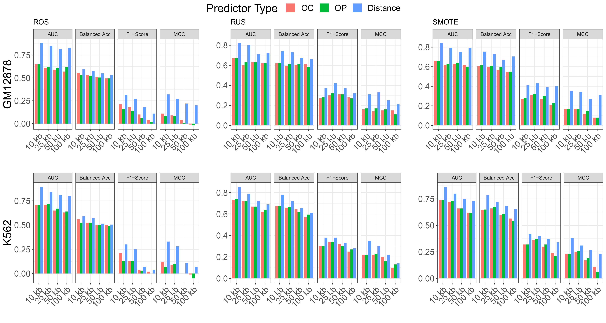
Distance-Type Predictors Further Improve Model Performance

Slide 30
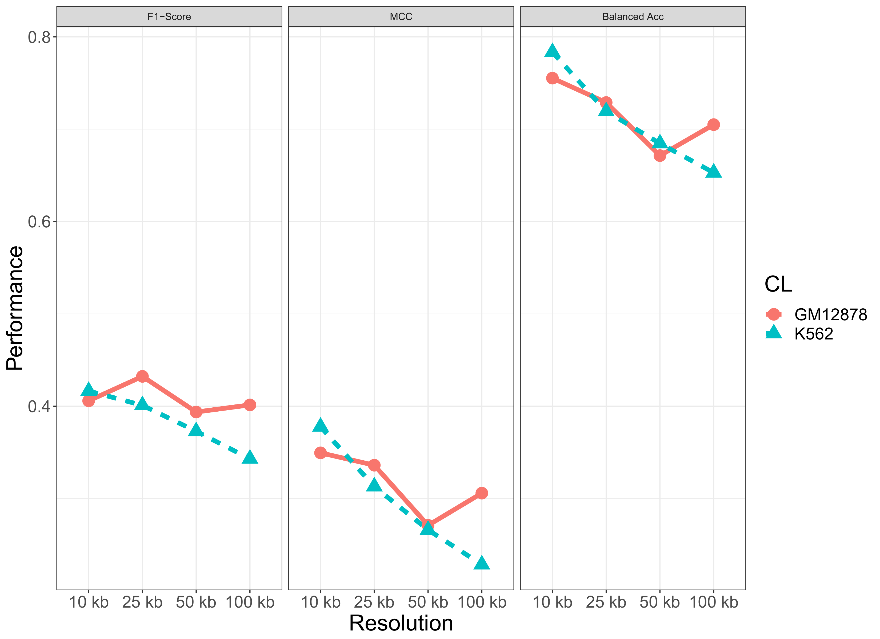
Models Implemented on SMOTE Re-Sampled Data with Distance-Type Predictors Performed Best
More info

Slide 31
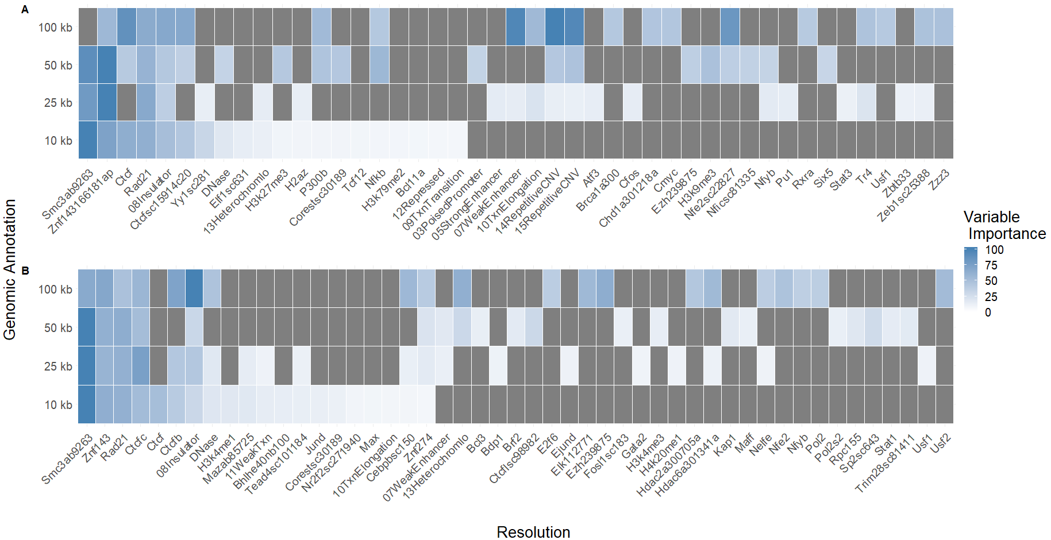
Variable Importance Heatmaps

Slide 32
Variable Importances Confirm Familiar Biological Signficance

